Slide 1
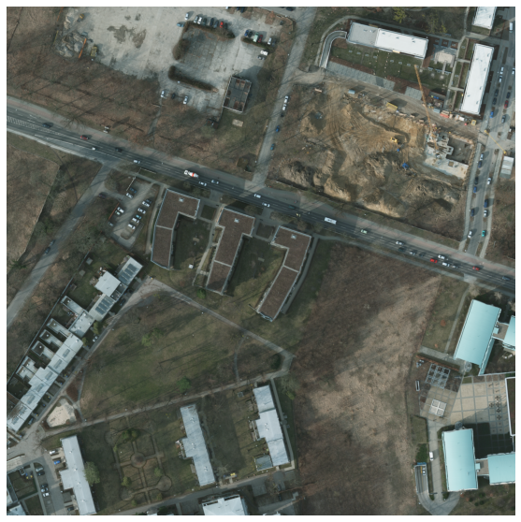
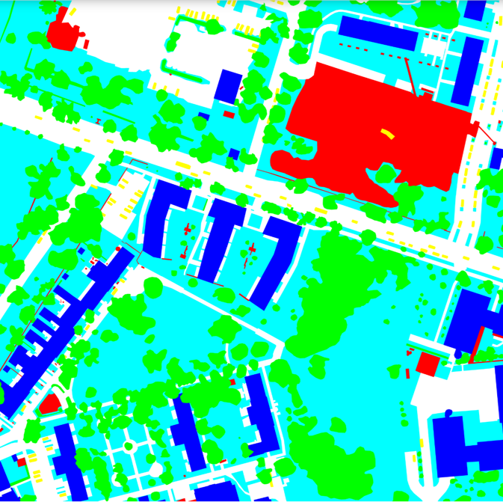
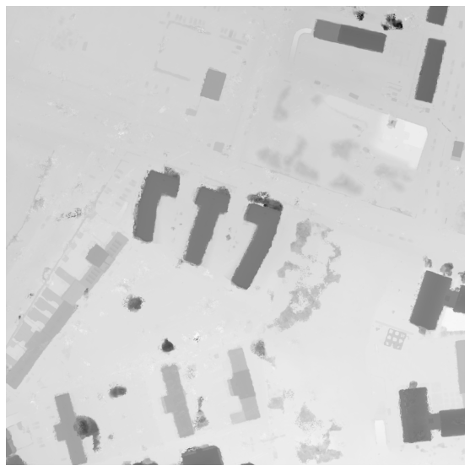

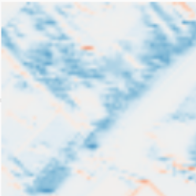

48×128×128
SSRL
48×128×128
Decoder
R1
SSRL
MRFM
3×512×512
D1
48×128×128
48×128×128
RGB
96×64×64
SSRL
96×64×64
HRNet
R2
SSRL
MRFM
D2
96×64×64
DSM
96×64×64
1×512×512
192×32×32
SSRL
192×32×32
R3
SSRL
MRFM
D3
192×32×32
192×32×32
384×16×16
SSRL
384×16×16
R4
SSRL
MRFM
D4
384×16×16
384×16×16
(a) Framework of the proposed method
MLP
1×C*×C
C×1×1
1×1×C
Conv1D_1
GAP
Mish
Sigmoid
Reshape
C×H×W
Conv1D_k
1×1×C
C×H×W
Spectral Attention
HW×C
Softmax
HW×C
Conv2D_1_R
Q
Spatial Attention
Conv2D_3
HW×HW
C×HW
Conv2D_1 _R
K
C×H×W
HW×C
Conv2D_1 _R
V
(b) Spectral-Spatial Representation Learning Module (SSRL)
Conv2D_1_R
Channel
Embedding
RGB and DSM
Feature Map
HW×1
LayerNorm
GELU
C/r×1×1
Rn
Dn
Softmax
C/r×1×1
Residual
GAP
Global Average Pooling
HW×1
ADAPTIVE
AVGPOOL2D
Conv1D_k
1D Convolution
(kernel size=k)
DSM: C×H×W
C×1×1
Transform
C/r×r×HW
Context Modeling
C/r×r×HW
Conv2D_1 _R
2D Convolution
With Reshape operation
Conv2D_1_R
Softmax
C/r×r×r
RGB: C×H×W
Conv2D_1 _R
C/r×HW×r
C×H×W
(c) Multimodal Representation Fusion Module (MRFM)

Slide 2
128×128×128
SSRL
128×128×128
Decoder
R1
SSRL
MRFM
3×512×512
D1
128×128×128
128×128×128
RGB
256×64×64
SSRL
96×64×64
ConvNeXt
R2
SSRL
MRFM
D2
96×64×64
DSM
256×64×64
1×512×512
512×32×32
SSRL
192×32×32
R3
SSRL
MRFM
D3
192×32×32
512×32×32
1024×16×16
SSRL
384×16×16
R4
SSRL
MRFM
D4
384×16×16
1024×16×16
(a) Framework of the proposed method
MLP
1×C*×C
C×1×1
1×1×C
Conv1D_1
GAP
Mish
Sigmoid
Reshape
C×H×W
Conv1D_k
1×1×C
C×H×W
Spectral Attention
HW×C
Softmax
HW×C
Conv2D_1_R
Q
Spatial Attention
Conv2D_3
HW×HW
C×HW
Conv2D_1 _R
K
C×H×W
HW×C
Conv2D_1 _R
V
(b) Spectral-Spatial Representation Learning Module (SSRL)
Conv2D_1_R
Channel
Embedding
RGB and DSM
Feature Map
HW×1
LayerNorm
GELU
C/r×1×1
Rn
Dn
Softmax
C/r×1×1
Residual
GAP
Global Average Pooling
HW×1
ADAPTIVE
AVGPOOL2D
Conv1D_k
1D Convolution
(kernel size=k)
DSM: C×H×W
C×1×1
Transform
C/r×r×HW
Context Modeling
C/r×r×HW
Conv2D_1 _R
2D Convolution
With Reshape operation
Conv2D_1_R
Softmax
C/r×r×r
RGB: C×H×W
Conv2D_1 _R
C/r×HW×r
C×H×W
(c) Multimodal Representation Fusion Module (MRFM)

Slide 3
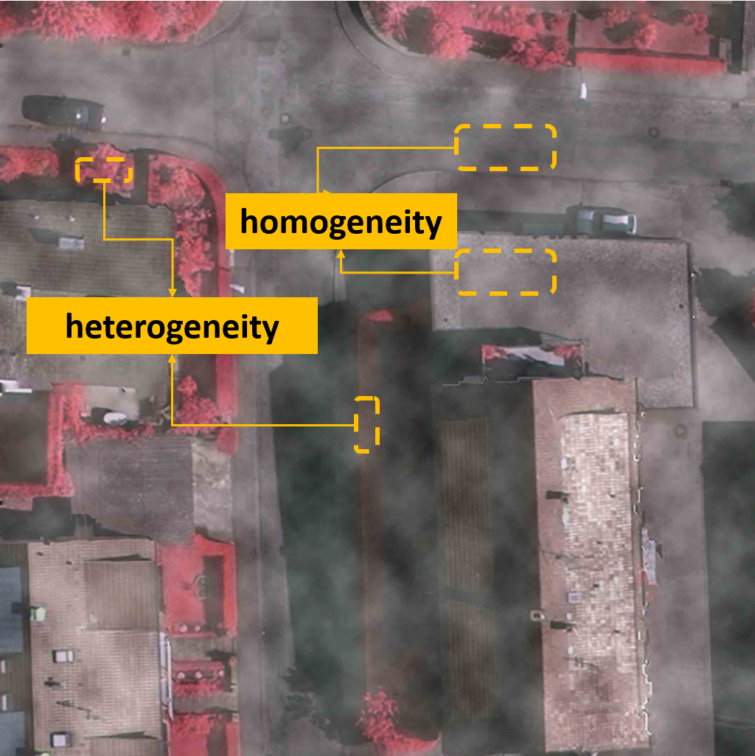
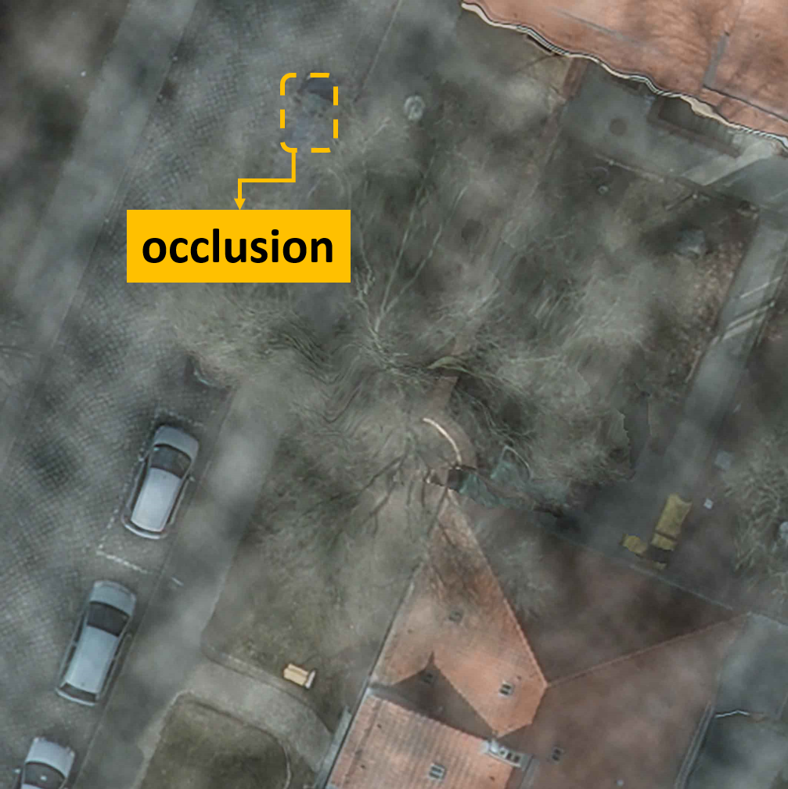
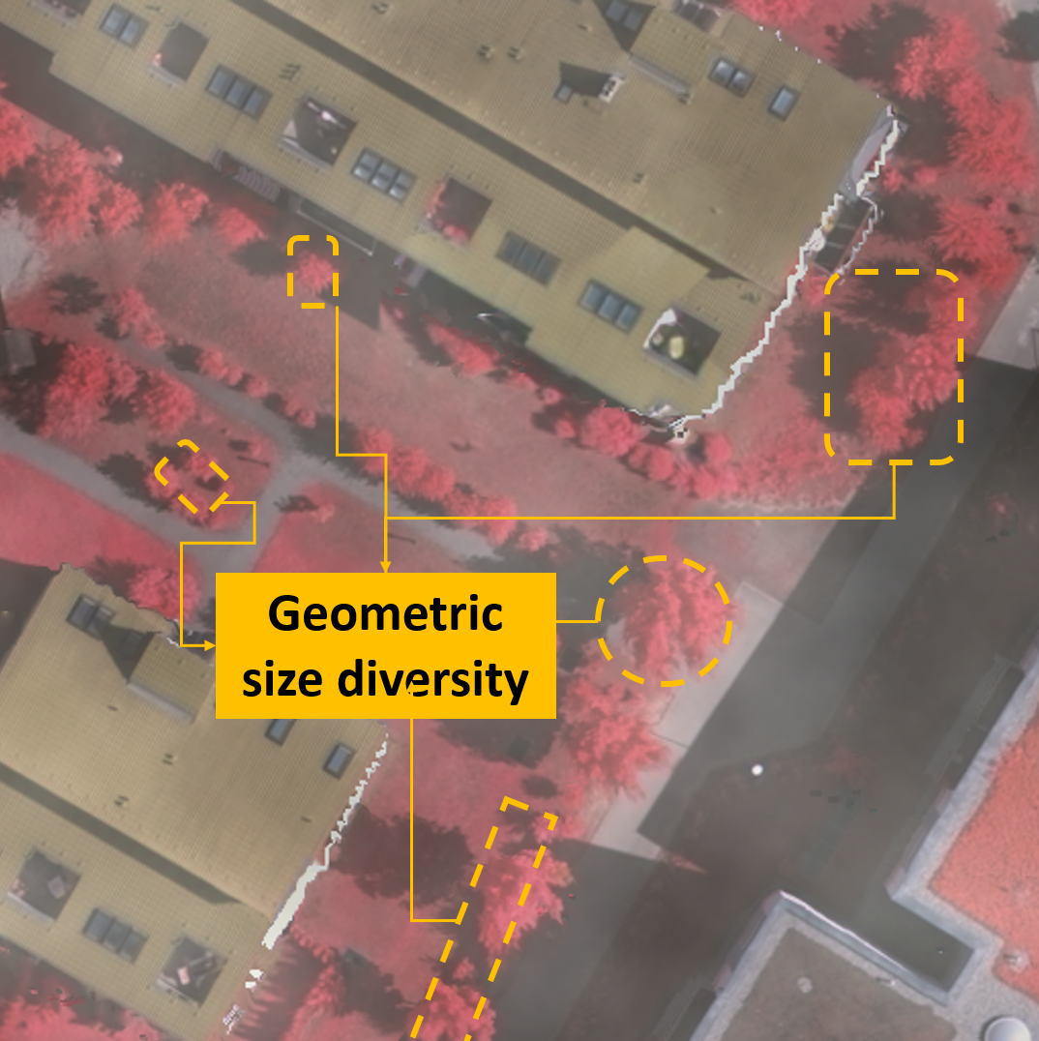
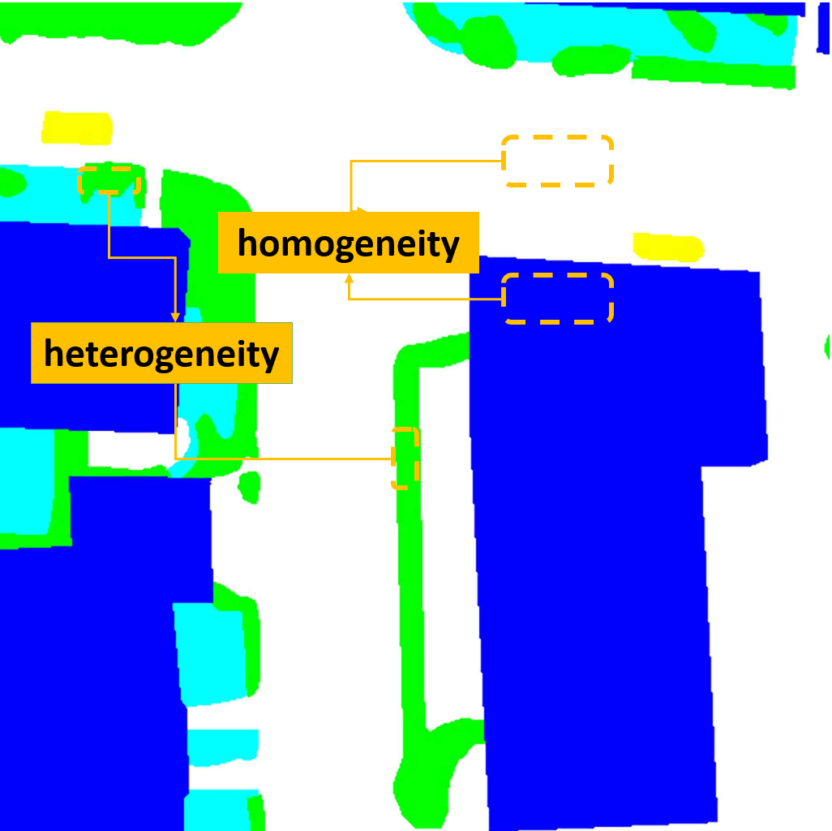
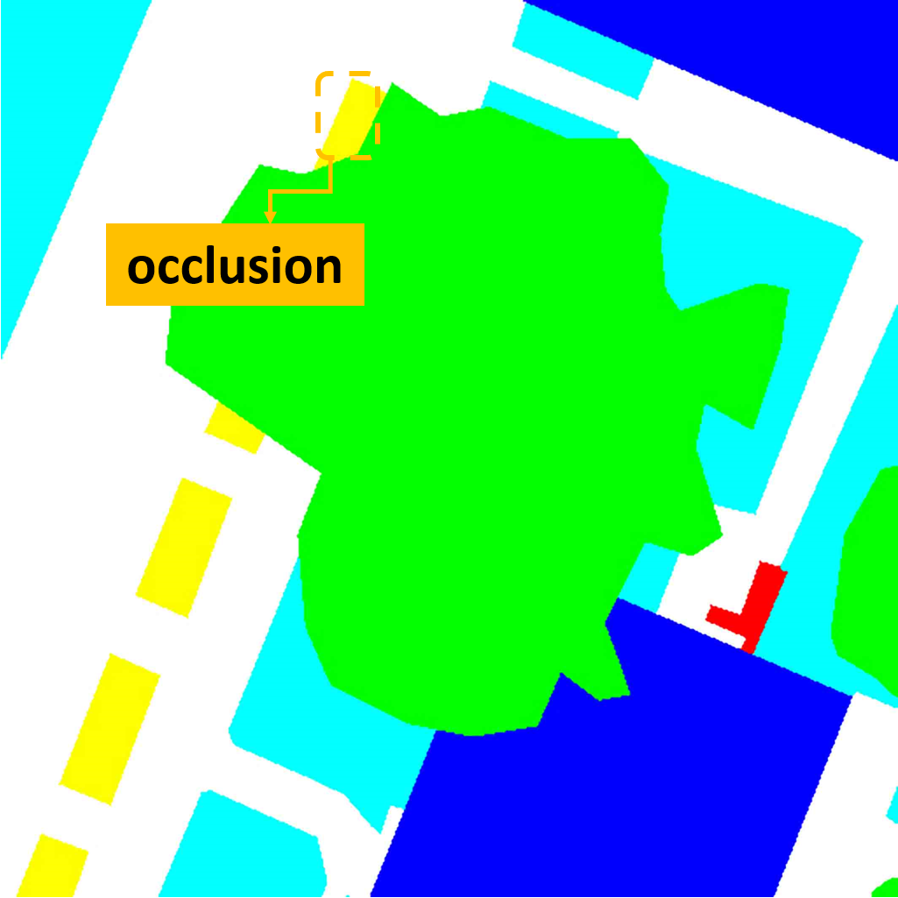
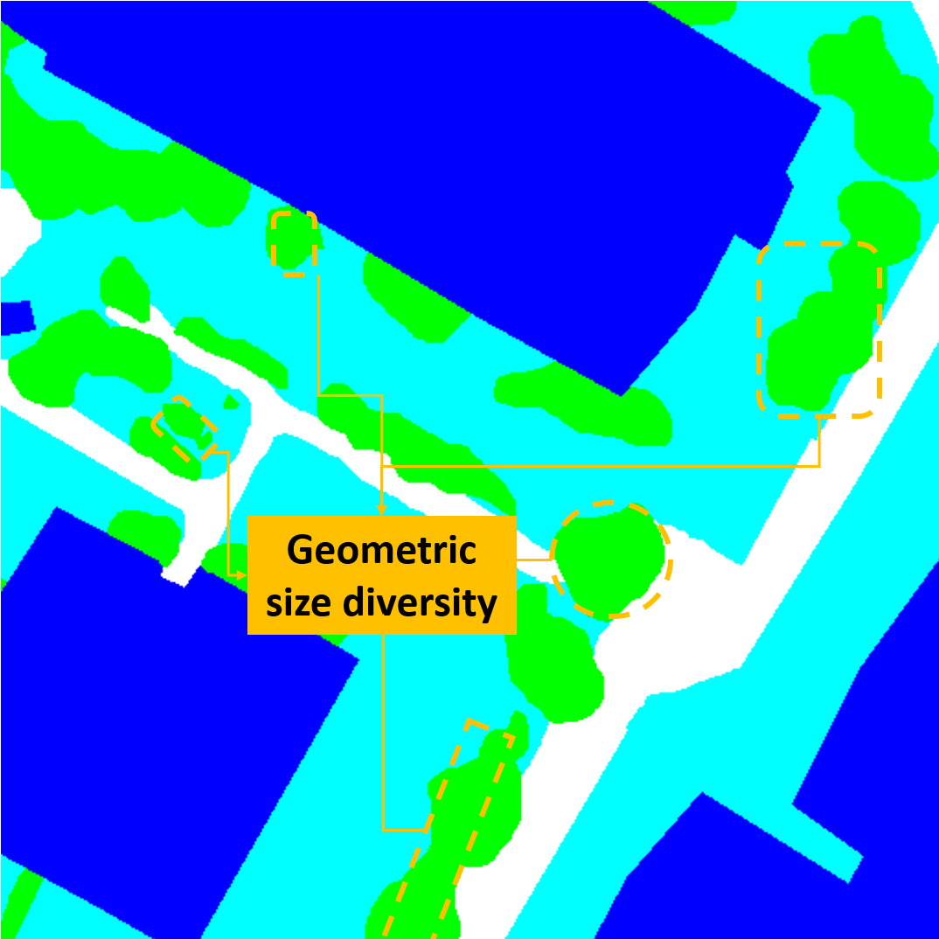
Clutter/ Background | Building | Low Vegetation | Car | Tree | Impervious surfaces

Slide 4
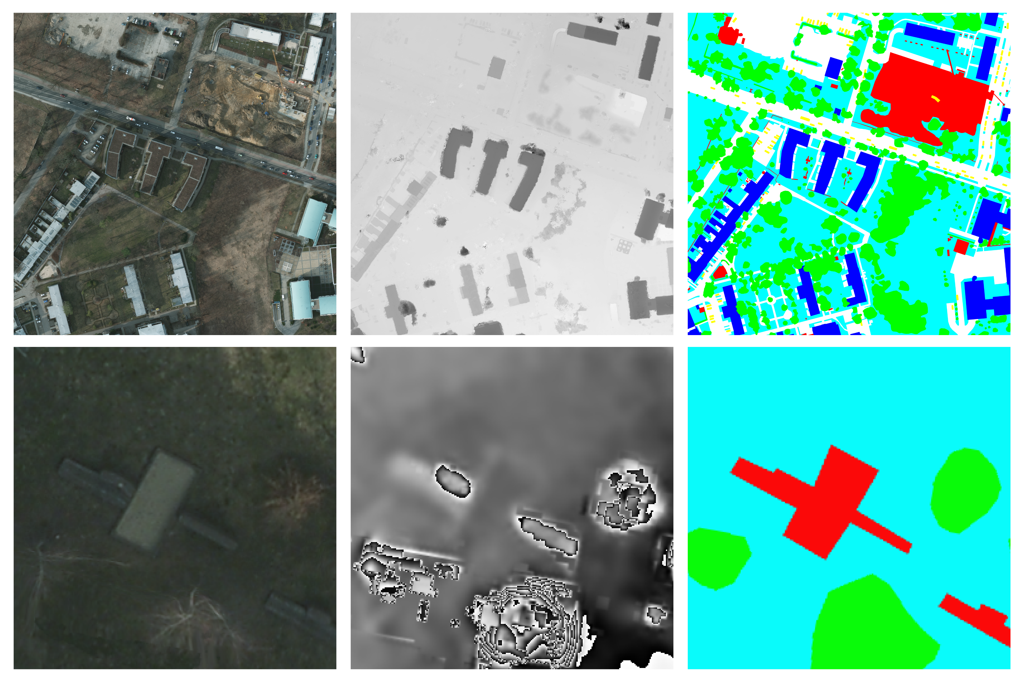
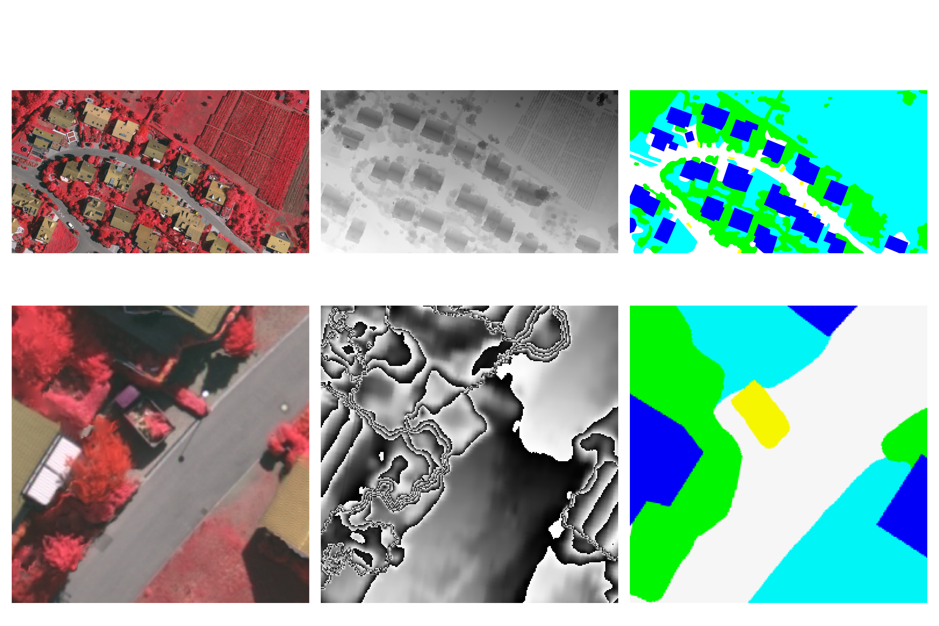
Clutter/ Background | Building | Low Vegetation | Car | Tree | Impervious surfaces
Original
Augmented
(a) Aerial Image (b) DSM (c) Label (a) Aerial Image (b) DSM (c) Label
Potsdam Vaihingen

Slide 6
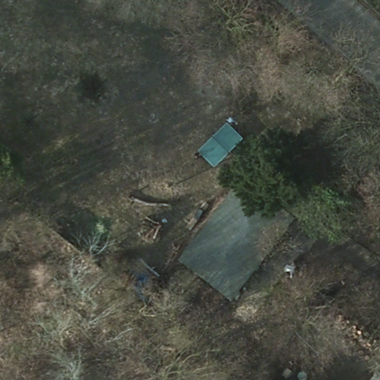
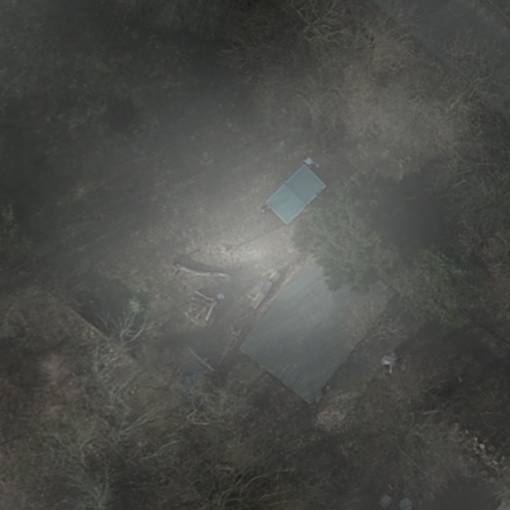
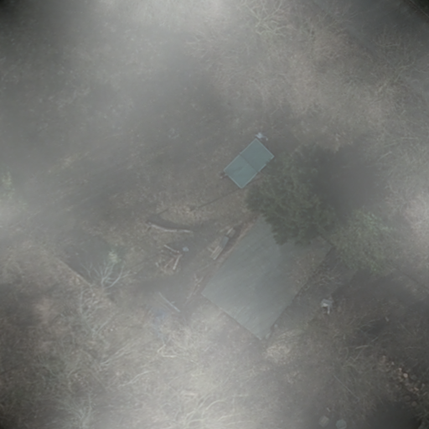
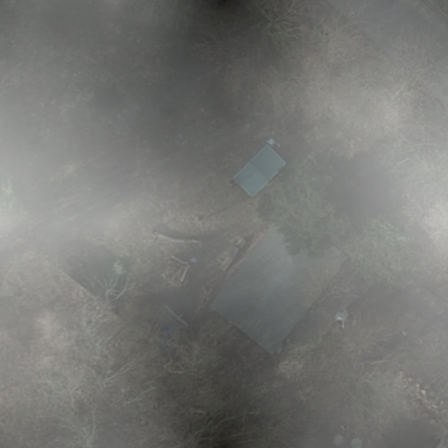
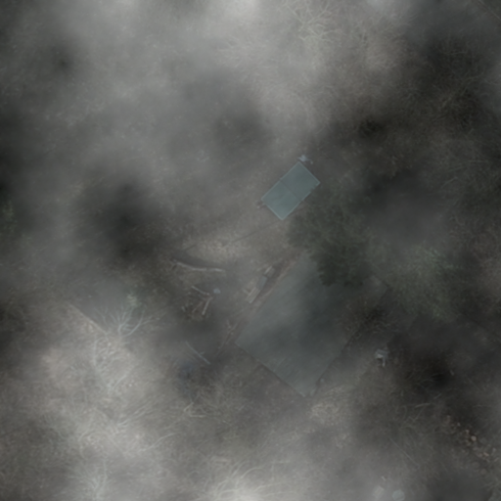
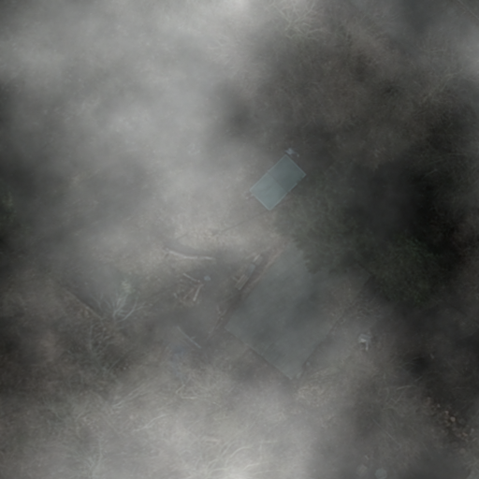
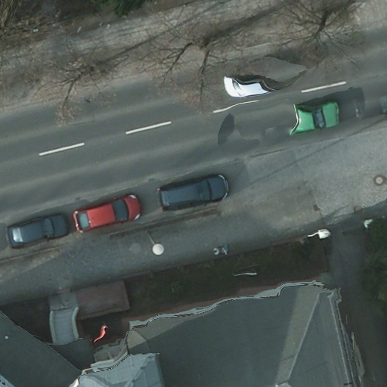
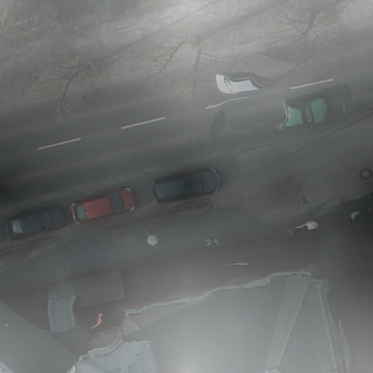
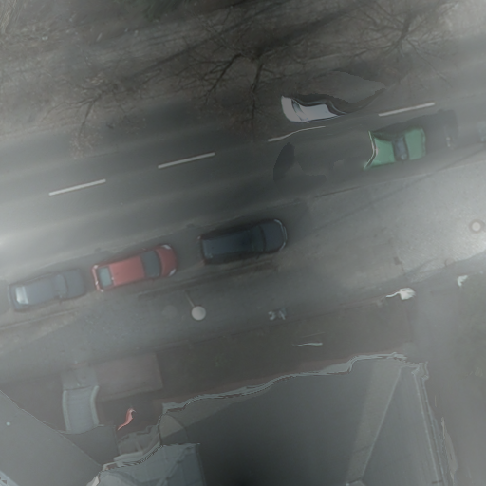
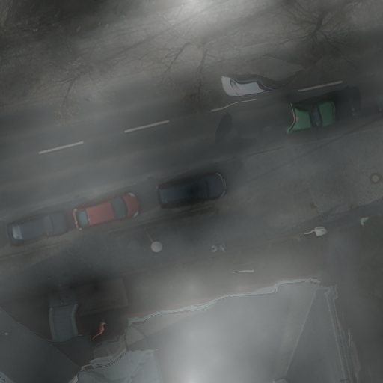
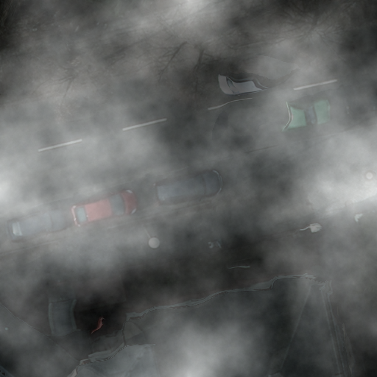
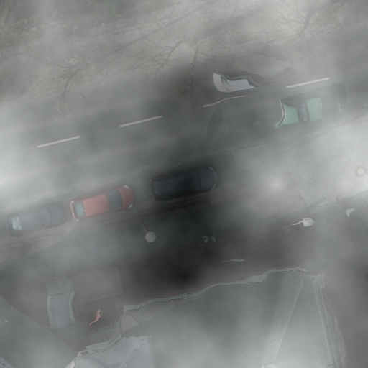

Slide 7
